Slide 1

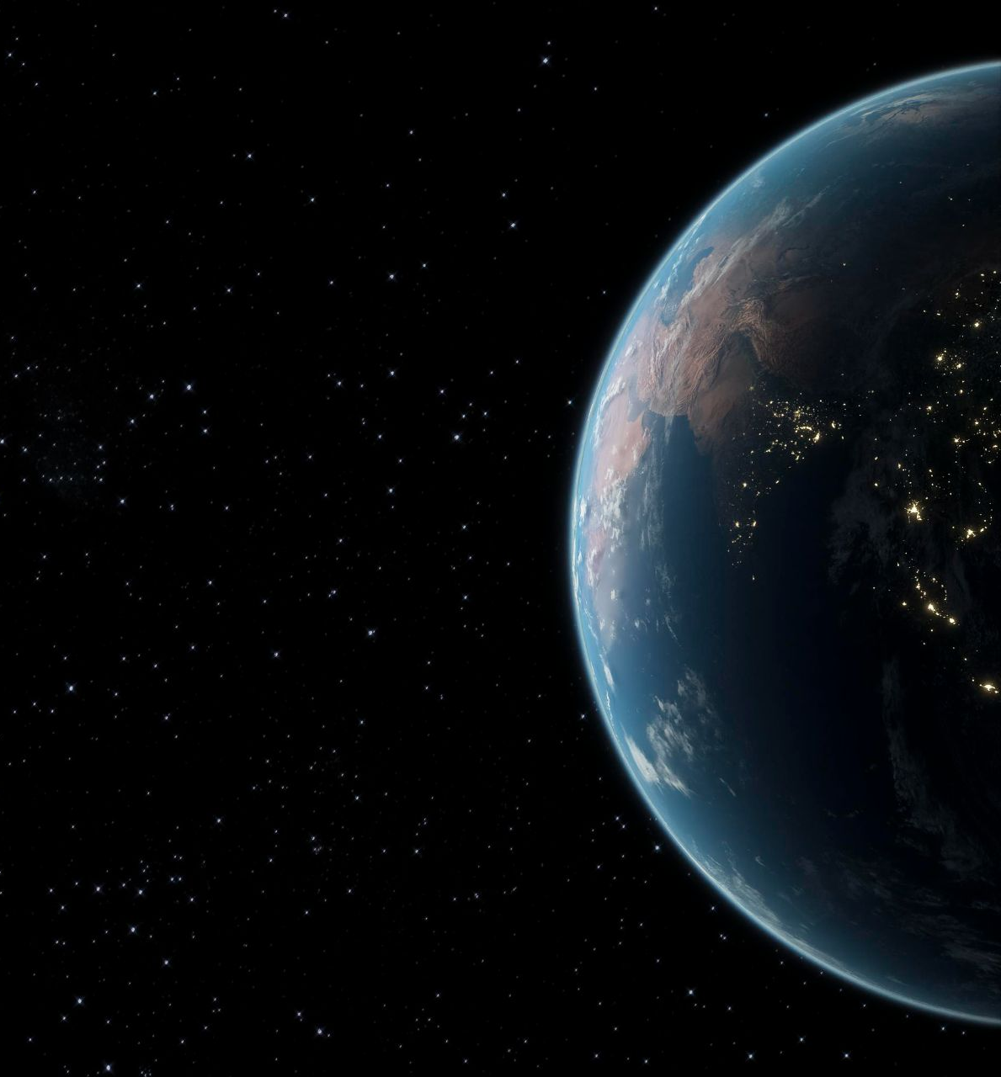
Gravitational Waves Detection
Stefanos Manios dit2416dsc@go.uop.gr

Slide 2

Gravitational Waves
Predicted by Albert Einstein in 1916 as ripples in spacetime
Generated by massive accelerating objects (e.g. black holes, neutron stars)
Travel at the speed of light, unaffected by matter
First direct detection in 2015 by LIGO — a major breakthrough
A complete quantum theory of gravity remains an open problem

Slide 3
—LIGO announcement
„“We have detected gravitational waves. We did it!”

Slide 4
01
02
03
04
Dataset
EDA
Modeling
Results

Slide 5

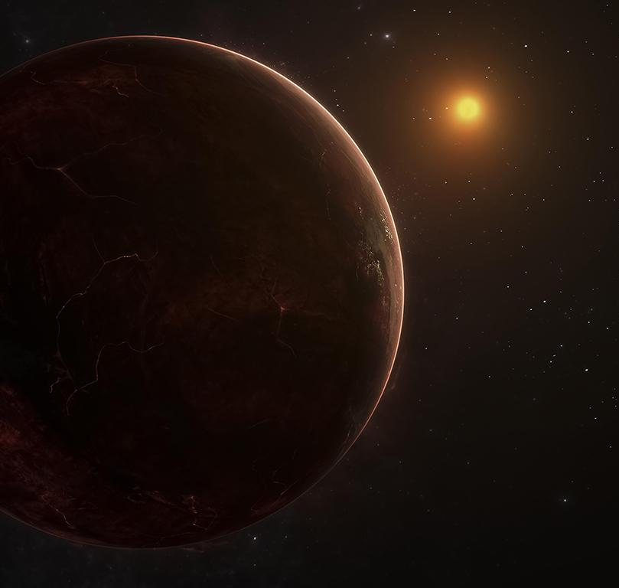
01
Dataset

Slide 6

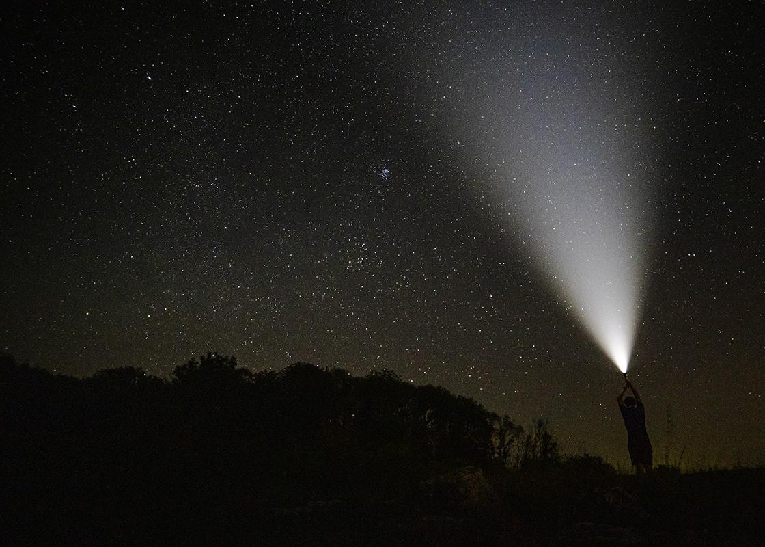
G2Net Gravitational Wave Detection
Based on the G2Net Gravitational Wave Detection dataset from Kaggle
Contains time-series data from LIGO interferometers
Signals labeled as "with" or "without" gravitational wave
Und das Wichtigste: Das Publikum wird den Sinn deiner Präsentation nicht verfehlen

Slide 7

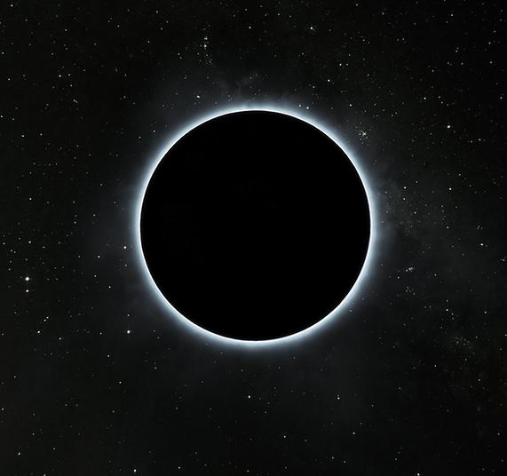
10% of Dataset Used
~56,000 npy files of total 560,000
~8 GB

Slide 8
Dataset Balance
With Wave 49%
Without Wave 51%

Slide 9

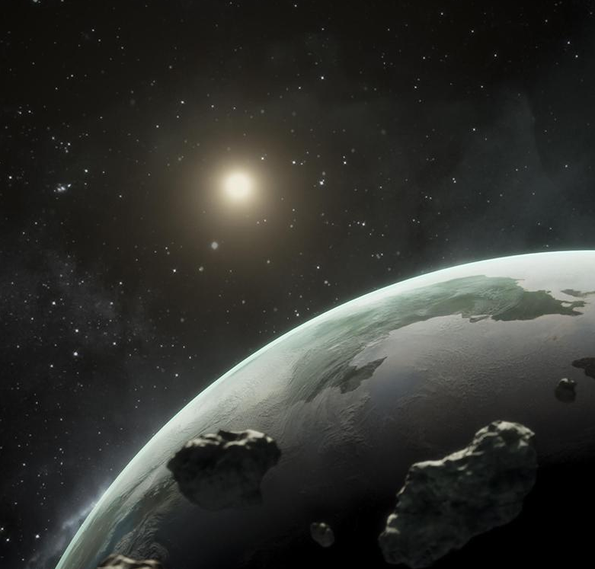
02
EDA

Slide 10
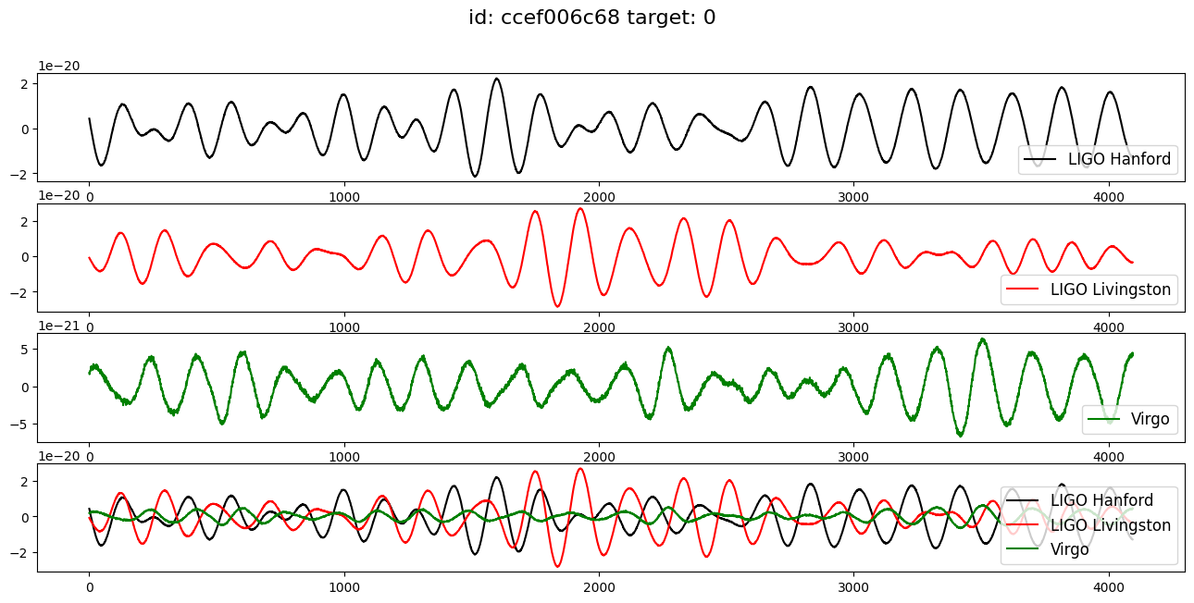
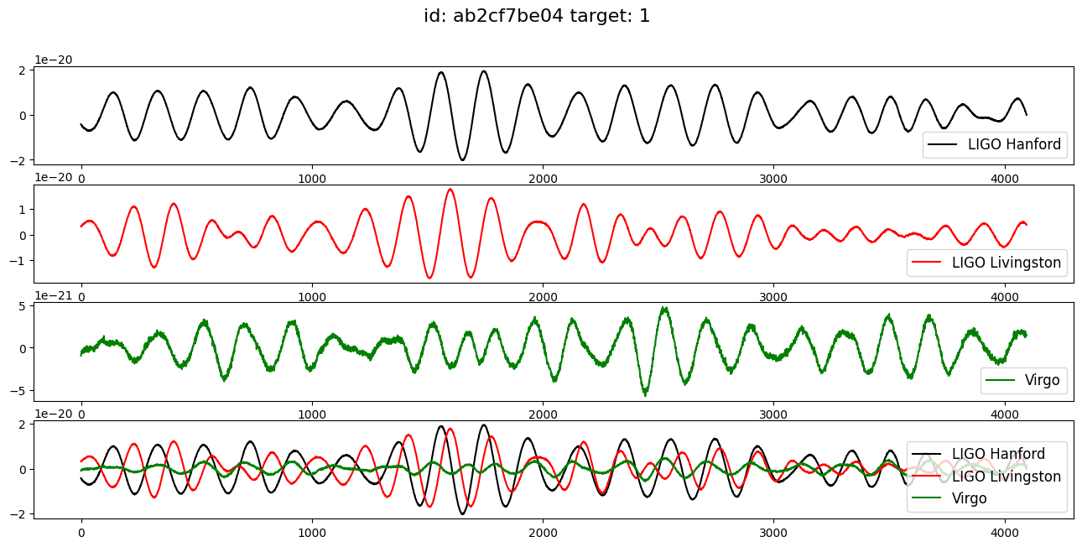
No Wave
Wave

Slide 11
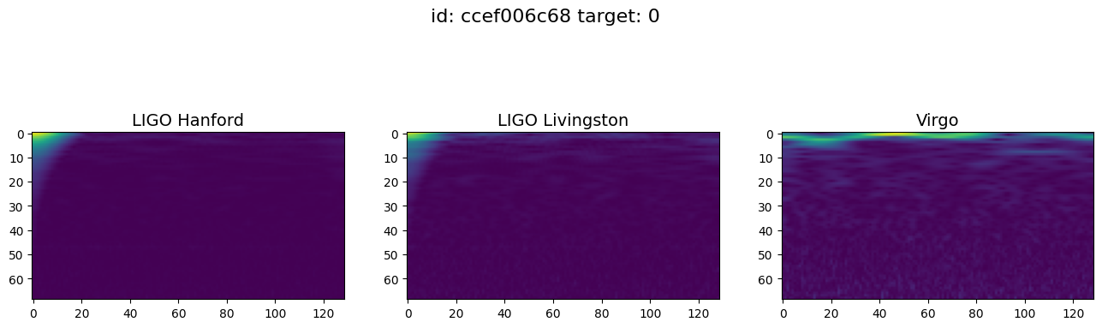
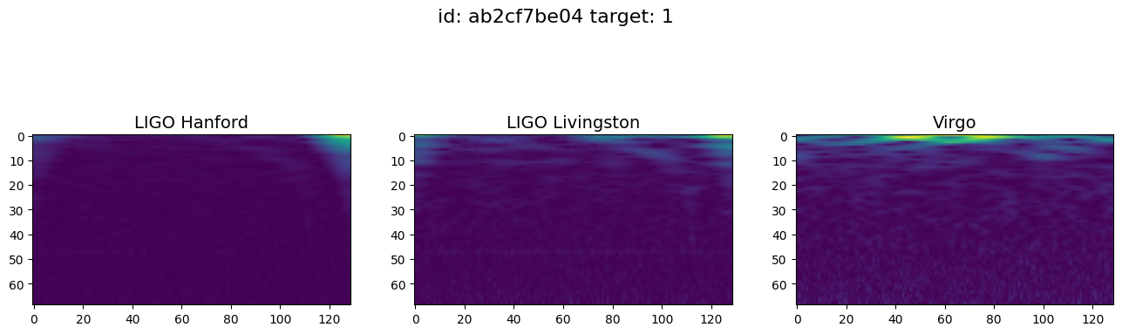
No Wave
Wave

Slide 12

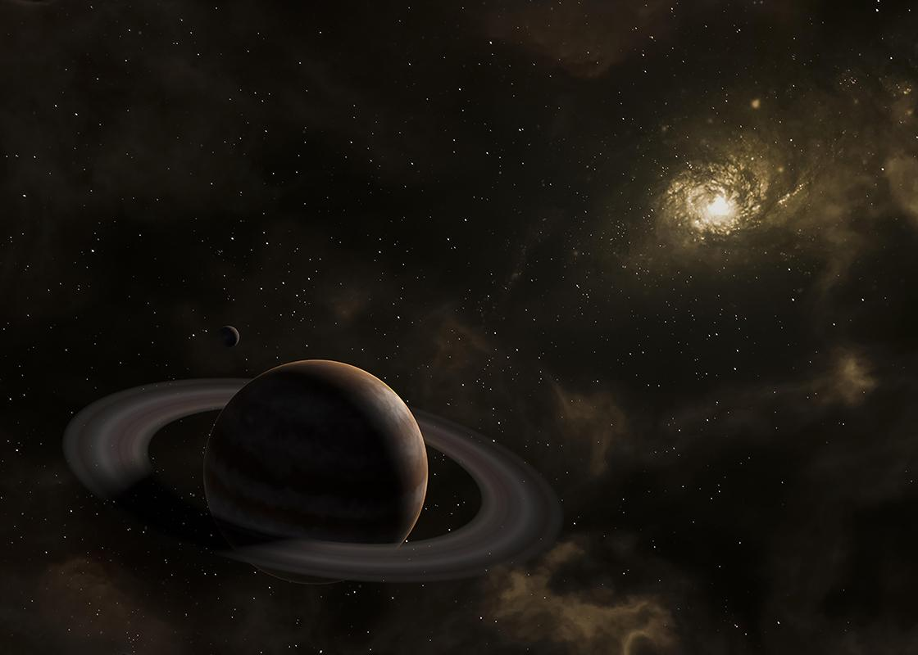
Preprocessing
Converted raw time-series signals to Mel-scaled spectrograms
Applied band-pass filtering to remove low/high frequency noise
Normalized signal amplitudes across all samples
Jupiter ist der größte in unserem Sonnensystem!

Slide 13
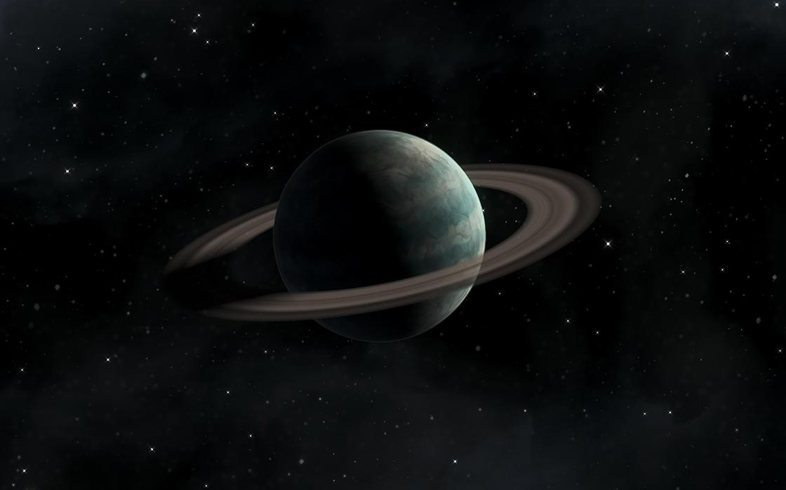
03
Modeling
<<<<<<
<<

Slide 14
Modeling
Input
Conv2D
Evaluation
RGB spectrogram image of shape (128 × 128 × 3)
(32 filters, 3×3) → MaxPooling
Accuracy, AUC, Precision, Recall

Slide 15
Modeling
3 Convolutional Blocks
Conv2D layer with 32 filters and 3×3 kernel, padding='same’
BatchNormalization layer for training stability
ELU activation function for better gradient flow
MaxPooling2D layer to reduce spatial dimensions

Slide 16
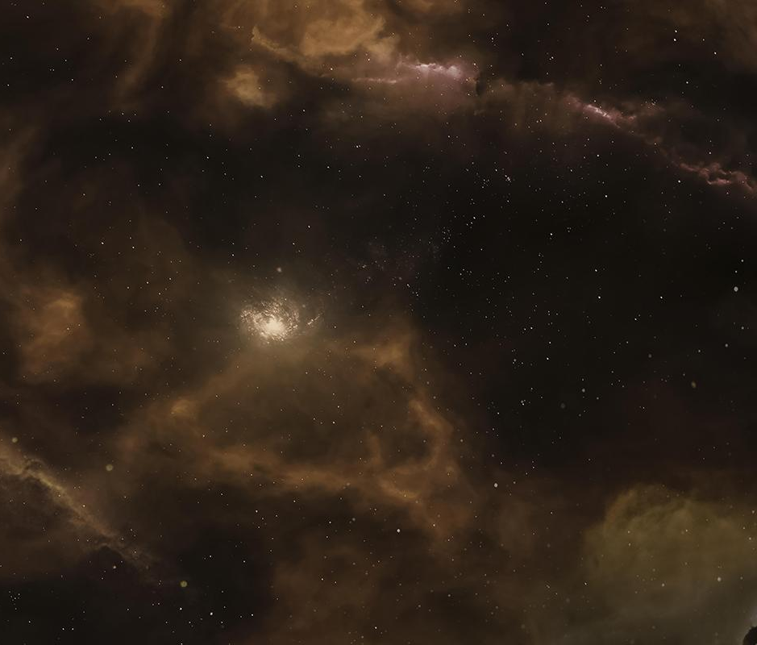
04
Results
<<<<<<
<<

Slide 17
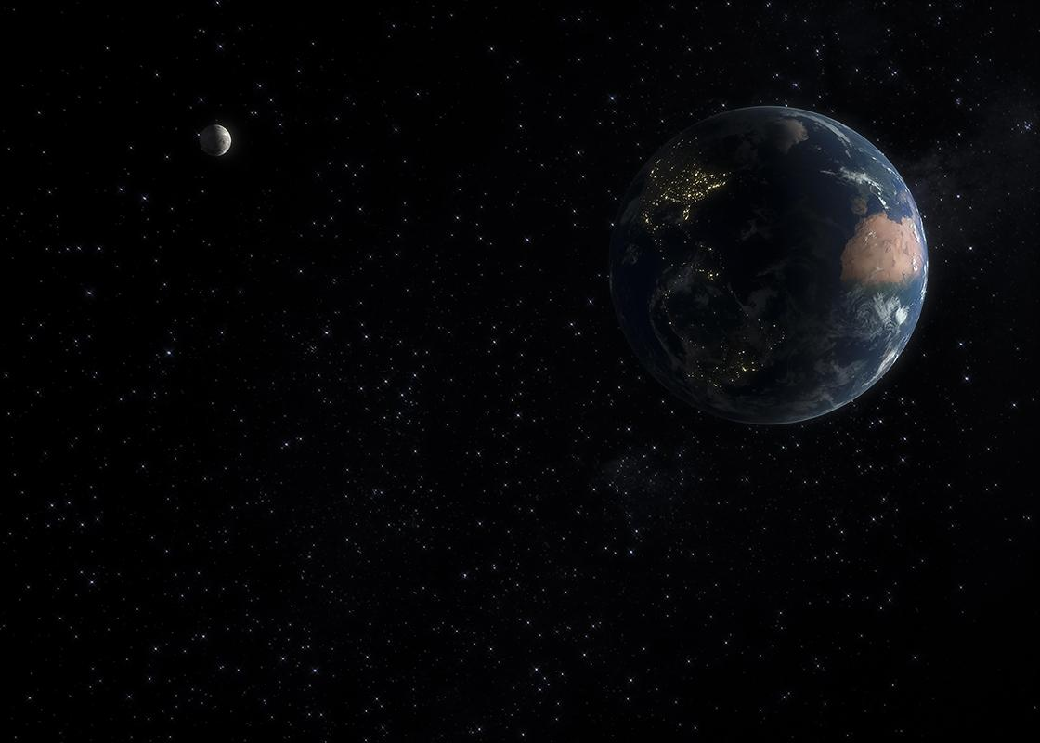
0.678
<<CX
Our Best model accuracy
<<<<<

Slide 18
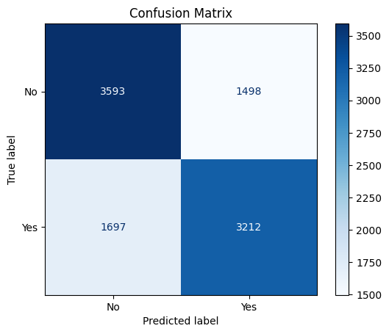
Confusion Matrix

Slide 19
Future Work
Preprocessing
<<<<<<
Training
Ensemble
<<
Advanced Noise Filtering
Combine predictions from multiple models
Full Datatset
Train the model in ~560000 samples

Slide 20
Thank You!!!

